Slide 1
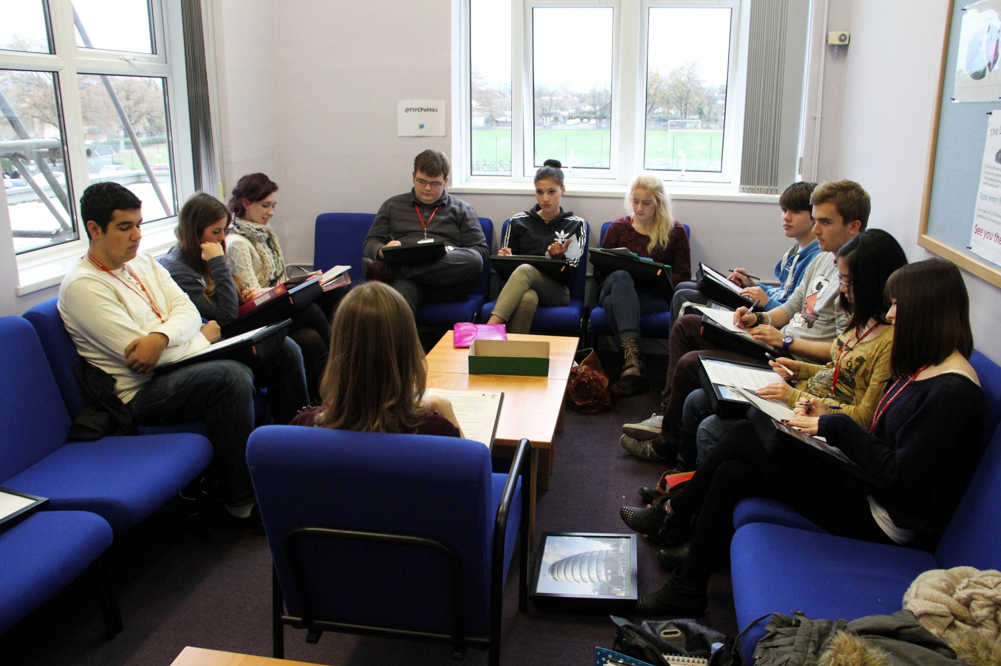
Do seminars encourage independent learning?

Slide 2
What is a seminar in Law / Politics?
A forty-five minute discussion with half a class
All students are allocated to a particular group
One timetabled seminar slot per week, in place of a whole lesson
Introduced for A2 lessons from September 2011

Slide 3
Rationale behind seminars
To encourage students to take more responsibility for their own learning
To prepare students for study at university level
To persuade students to undertake greater background reading
To provide an less intimidating forum for less vocal students to participate in discussions
To stretch the more able students
To equip students with detailed knowledge needed for exams

Slide 4
Learning environment
Law office was converted into a purpose built seminar room
The room can accommodate up to a class of twenty if required
Lap trays are available in place of desks
Comfy chairs and coffee tables

Slide 5
In practice - LAW
Seminar takes place during the last timetabled lesson of each week
Students have usually been given an article to read and questions to answer beforehand
Wider themes arising from article can be tackled and discussed more fully in seminar itself
Students expected to stay in classroom to complete work set for other half of timetabled time

Slide 6
In practice - POLITICS
Seminar takes place during the first timetabled lesson of each week
Students have been given reading or viewing material to work through and structured notes to devise in booklets
Wider themes arising from reading / viewing can be tackled and discussed more fully in seminar itself
Students not expected to stay in classroom for other half of lesson

Slide 7
Teachers’ perspective
Pros | Cons
Greater engagement in class discussions Spontaneous discussion Increased participation from less vocal students Wider reading undertaken outside of lessons Students become familiar with university style learning | Weekly lesson time ‘lost’ Insufficient preparation by a minority Some students a bit too relaxed Over reliance on teacher by a few students

Slide 8
Students’ perspective (May 2013)
Helped to consolidate learning
Allows reflection and clarification on previous learning
A good motivation to do the preparation reading
‘Missed’ half a lesson of contact time with teacher
More individual attention from class teacher
Broader and deeper understanding of a topic
Not always enough exam focus
Diverse viewpoints could be expressed
Appreciated the value, with hindsight- ideal preparation for university
Smaller group sizes encouraged discussion
Imbalance of work load

Slide 9
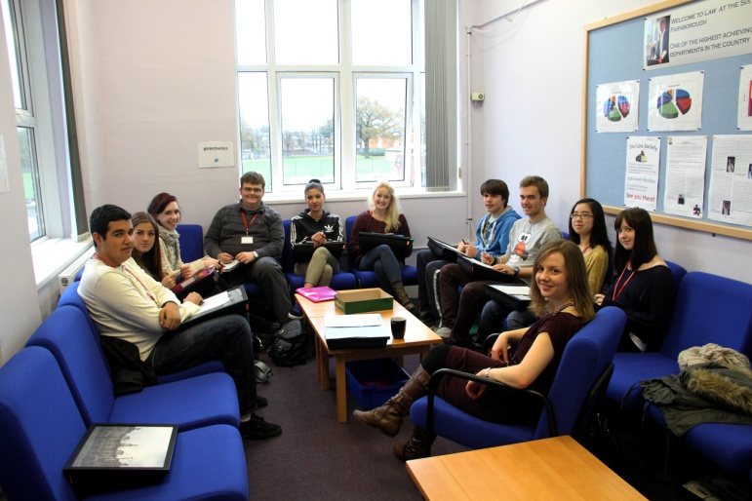
Developing the seminar format – September 2012
Students required to stick to their allocated seminar group – no ‘chopping and changing’ allowed.
Politics reshuffled the groups twice during the year
Clear preparation tasks placed on Moodle and emailed to students on weekly basis

Slide 10
Have seminars had a positive effect?
Teaching- less teaching time
Learning- students forced to be more independent
Achievement- results remain positive, no dip

Slide 11
Looking ahead- 2013 and beyond
Would the seminars work
with AS students?
Will the A level reforms
allow more time to
experiment with seminars?
Can the seminar format be
adopted by other subjects?

